Slide 1
African American Veterans

Slide 2
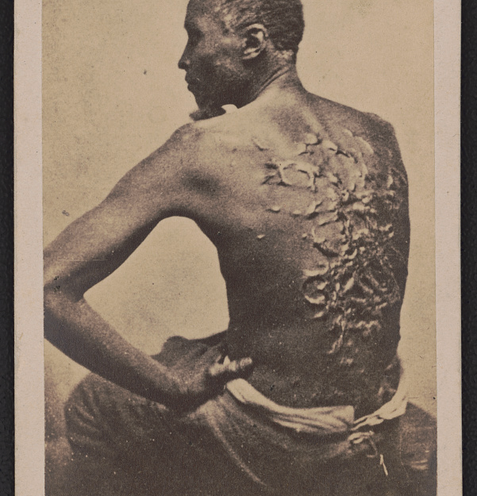
Gordon
This image of a former slave, called Gordon, displays scars received while working on a Louisiana plantation.
Gordon escaped to Union lines in 1863.
Gordon enlisted in the U.S. Army and fought in the Siege of Port Hudson on the Mississippi River.

Slide 3
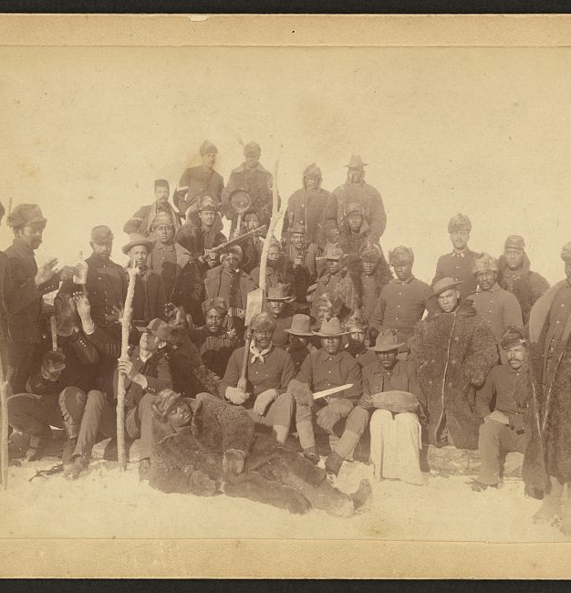
The 9th and 10th Cavalries and the 24th and 25th Infantries
They were Civil War units comprised of African American soldiers.
These units helped protect the nation’s westward expansion by building roads and participating in significant military actions and served among the first national park rangers.
They were given the name “Buffalo Soldiers” by Native Americans. There are two possible reasons why they were given this name:
The soldiers’ dark curly hair resembled a buffalo mane.
The soldiers’ ferocity and courage were reminiscent of the tenacity of the Great Plains buffalo.
Mark Matthews, the nation’s oldest living buffalo soldier, died in 2005 at age 111 in Washington, D.C. For many early African American soldiers, serving in the military was a chance to try to acquire equal rights.

Slide 4
Sources:
Gordon: https://www.loc.gov/item/2018648117/
Title: [Escaped slave Gordon, also known as "Whipped Peter," showing his scarred back at a medical examination, Baton Rouge, Louisiana]
Contributor Names: McPherson & Oliver, photographer
Created / Published: Baton Rouge, La. : [Publisher not identified], [2 April 1863]
Subject Headings:
African Americans--Punishment & torture--1860-1870
Fugitive slaves--Louisiana--Baton Rouge--1860-1870
Wounds & injuries--1860-1870
United States--History--Civil War, 1861-1865--African Americans--Louisiana--Baton Rouge
Headings: Albumen prints--1860-1870; Cartes de visite--1860-1870; Portrait photographs--1860-1870.
Genre: Portrait photographs--1860-1870; Albumen prints--1860-1870; Cartes de visite--1860-1870
Library of Congress Control Number: 2018648117
Reproduction Number: LC-DIG-ppmsca-54375 (digital file from original, front) LC-DIG-ppmsca-54376 (digital file from original, back)
Notes:
Title devised by Library staff.
Printed on verso: "From life, taken at Baton Rouge, La., April 2d, 1863.“
On verso: Facsimile of original medical report to Colonel L.B. Marsh from J.W. Mercer, assistant surgeon with the 47th Massachusetts Volunteers, at Camp Parapet, Louisiana.
Gift; Tom Liljenquist; 2016; (DLC/PP-2017:171, formerly deposit D072)
Purchased from: Thanatos Archive, Duvall, Washington, October 2016.
Forms part of: Liljenquist Family Collection of Civil War Photographs (Library of Congress).
pp/liljpaper

Slide 5
Sources:
Buffalo Soldiers: https://www.loc.gov/item/98501226/
Title: [Buffalo soldiers of the 25th Infantry, some wearing buffalo robes, Ft. Keogh, Montana] / Chr. Barthelmess, photographer, Fort Keogh, Montana.
Created / Published: [18]90.
Subject Headings:
United States.--Army.--Infantry Regiment, 25th--People--Montana--Fort Keogh
African Americans--Military service—1890
Military personnel--Montana--Fort Keogh--1890
Headings: Cabinet photographs—1890; Gelatin silver prints—1890; Group portraits—1890; Portrait photographs--1890.
Library of Congress Control Number: 98501226
Reproduction Number: LC-DIG-ppmsca-11406 (digital file from original item, front) LC-DIG-ppmsca-11407 (digital file from original item, back) LC-USZC4-6161 (color film copy transparency)
Notes:
"#5. Some of the coons that are in camp at Keogh taken Sunday morning, Dec. 14th '90" handwritten inscription in red ink on back.
Purchase; William A. Gladstone; 1995; (PR 13 CN 1995:113.274)
General information about the Gladstone collection is available at, http://hdl.loc.gov/loc.pnp/pp.gld

