Slide 1
African American Veterans

Slide 2
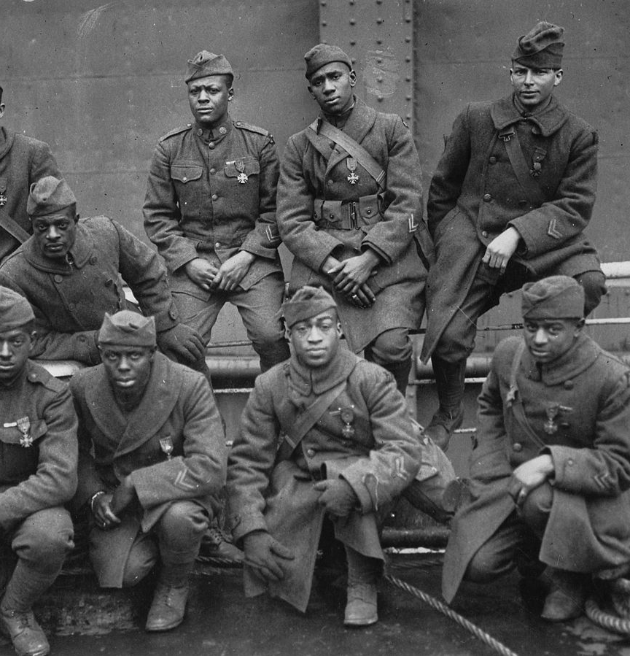
The Harlem Hellfighters
They fought during World War I as the 369th Infantry (formerly the 15th Regiment New York Guard).
The Hellfighters were assigned to the 16th Division of the French Army, where they helped repel the German offensive and launch a counteroffensive.
They fought a total of 191 days in combat-- longer than any other American unit in the war.
It was the Germans who first applied the “Hellfighters” moniker to the unit, and the 369th’s performance on the battlefield showed that the nickname had been well earned.
On May 15, 1918, Pvt. Henry Johnson and Pvt. Needham Roberts of the 369th were on sentry duty when their post was attacked by a German patrol. The two men fought off as many as two dozen Germans in brutal hand-to-hand combat. They earned the prestigious Croix de Guerre from the French army.
Despite their courage, sacrifice and dedication to their country, they returned home to face racism and segregation from their fellow countrymen.

Slide 3
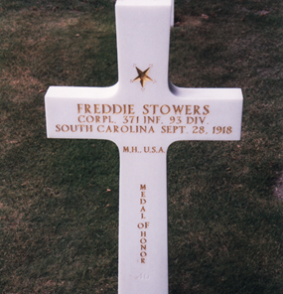
Corporal Freddie Stowers
Stowers joined the First Provisional Infantry Regiment (Colored) on Oct. 4, 1917.
While serving as squad leader of Company C, 371st Infantry Regiment, 93rd Division, Stowers’ company led an attack at Hill 188, Champagne Marne Sector, France.
Stowers led his company to the enemy trench line to take out a machine gun post which was causing most of the casualties.
Even though he was mortally wounded, Stowers continued to go on with his company and encouraged his men to go forward without him.
His motivation encouraged his troops to march forward and led to the capture of Hill 188.
Stowers' commanding officer recommended him for the Medal of Honor after his death, but the paperwork was misplaced.
It wasn’t until April 24, 1991, that Corporal Freddie Stowers was awarded the Medal of Honor for his valor during World War I.

Slide 4
Sources:
Harlem Hellfighters: https://commons.wikimedia.org/wiki/File:369th_15th_New_York.jpg
Description: "Some of the colored men of the 369th (15th N.Y.) who won the Croix de Guerre for gallantry in action." Left to right. Front row: Pvt. Ed Williams, Herbert Taylor, Pvt. Leon Fraitor, Pvt. Ralph Hawkins. Back Row: Sgt. H. D. Prinas, Sgt. Dan Strorms, Pvt. Joe Williams, Pvt. Alfred Hanley, and Cpl. T. W. Taylor. 1998 print. Records of the War Department General and Special. Staffs. (165-WW-127-8)
Date: 1919
Source: ARC Identifier: 26431282; US National Archives website
Author: By an unknown photographer

Slide 5
Sources:
Freddie Stowers: https://commons.wikimedia.org/wiki/File:CPL_Freddie_Stowers%27_grave_at_Meuse-Argonne_American_Cemetery.jpg
Description: English: Grave of CPL Freddie Stowers, posthumously awarded the Congressional Medal of Honour in 1991 for his actions on 28 September 1918
Date: 28 August 1998
Source: Own work
Author: Mztourist

